Slide 1
FWD Project
TOGAF 9 - Core Diagrams
Functional Decomposition Diagram
Phase B – Business Architecture

Slide 2
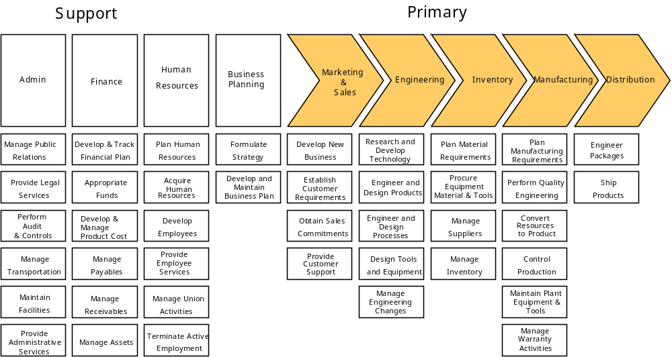
Functional Decomposition Diagram

Slide 3
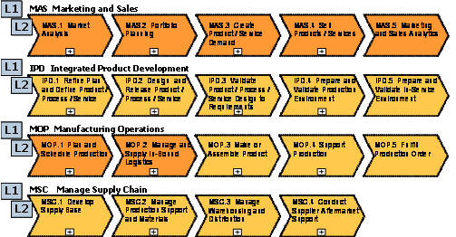
Functional Decomposition Diagram

Slide 4
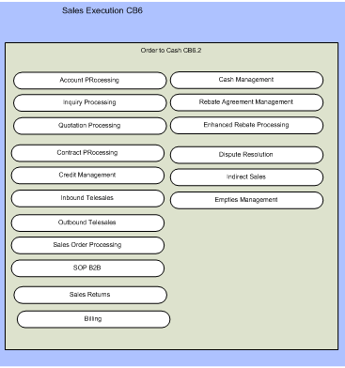
Functional Decomposition Diagram

